Slide 1
GEN AI FOR BUSINESS APPLICATIONS
YouTube Video
Q&A System
A Fully Local RAG-Based AI Application
Zero API Cost
100% Local
Llama 2
RAG Architecture
| Stevens Institute of Technology | 2026

Slide 2
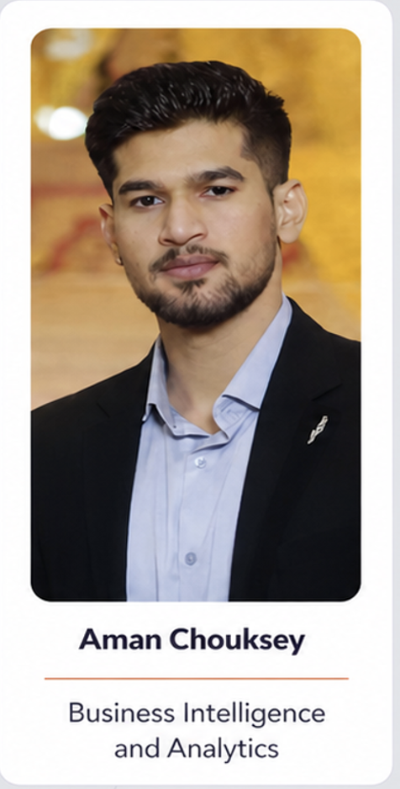
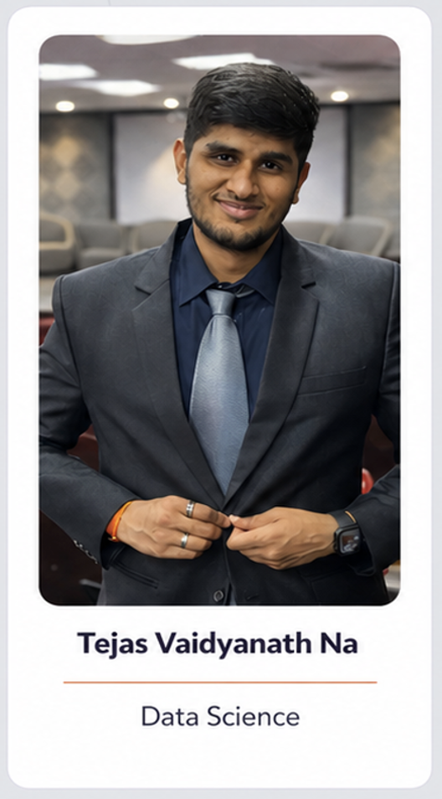
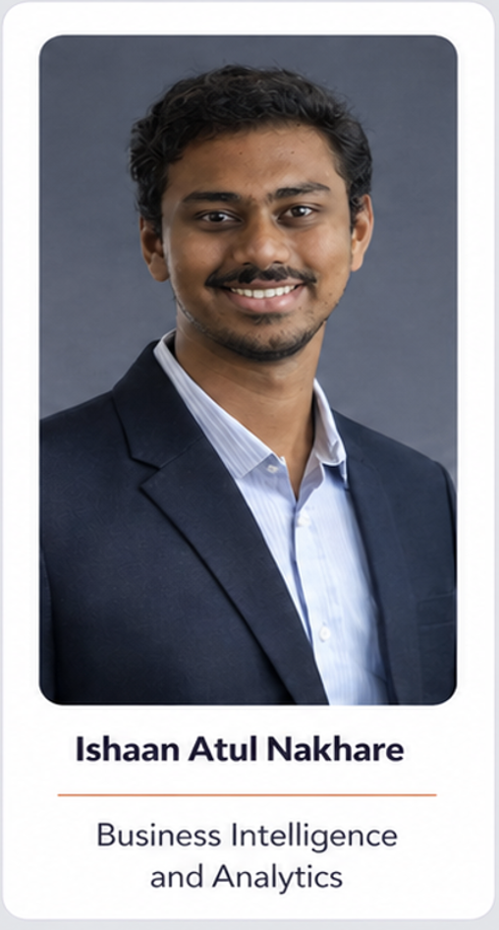
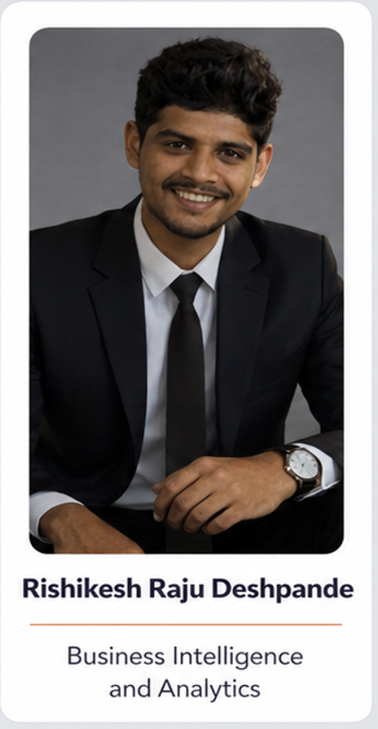
Presented by :-

Slide 3
The Problem & Our Solution
❌ THE PROBLEM
✅ OUR SOLUTION
Long YouTube videos are hard to navigate
Paste URL → ask any question instantly
Re-watching takes too much time
AI finds relevant parts automatically
→
No way to ask questions directly
Natural language Q&A interface
Cloud AI costs money per API call
Runs 100% locally — zero API cost
Sending data to cloud = privacy risk
Data never leaves your computer

Slide 4
The Core Concept: RAG
Retrieval Augmented Generation
💡 Analogy: You have a 500-page book and someone asks a question. You don't re-read the whole book — you find the relevant pages first, then answer from those pages. That's RAG.
R
RETRIEVAL
A
AUGMENTED
G
GENERATION
Find the most relevant chunks from the video transcript using semantic search
Add those relevant chunks as context to our prompt before sending to the AI
The AI generates a precise answer using only the provided context
Why RAG? LLMs don't know about your specific video. We can't feed the whole transcript (too long). RAG solves both problems — efficiently.

Slide 5
System Architecture
PHASE 1: INDEXING
PHASE 2: QUERYING
YouTube URL
→
Transcript
→
Text Chunks
→
Embeddings
→
ChromaDB
Question
→
Embedding
→
Top 3 Chunks
→
Prompt
→
Answer
User Input
youtube-transcript-api
500 words + 100 overlap
sentence-transformers
Vector Storage
User Input
sentence-transformers
Semantic Search
Q + Context
Ollama + Llama 2
Technology Stack
Layer
Technology
Purpose
Transcript
youtube-transcript-api
Extract video captions
Metadata
yt-dlp
Get title, duration, info
Embeddings
sentence-transformers
Convert text to vectors
Vector DB
ChromaDB
Store & search embeddings
LLM Runtime
Ollama
Run AI model locally
AI Model
Llama 2 (7B)
Generate answers
UI
Streamlit
Web interface

Slide 6
Key Concept: Embeddings
How computers understand the meaning of text
An embedding converts a sentence into a list of numbers (a vector) that captures its meaning. Similar sentences produce similar vectors — even if they use completely different words.
Example:
"I love dogs"
→
[0.23, -0.14, 0.87, 0.41, ...]
"I adore puppies"
→
[0.25, -0.12, 0.85, 0.39, ...]
"How do EVs work?"
→
[0.61, 0.23, -0.44, 0.17, ...]
🔑 Why this matters:
"I love dogs" and "I adore puppies" have almost identical vectors → ChromaDB knows they mean the same thing. This is SEMANTIC SEARCH — finding similar meaning, not just matching words.
Model used: all-MiniLM-L6-v2 (384-dimensional vectors)

Slide 7
Text Chunking & Vector Database
TEXT CHUNKING
CHROMADB — VECTOR DATABASE
Why chunk the transcript?
What makes it special?
LLMs have a context limit (can't read all at once)
Stores embeddings locally
Smaller chunks = more precise search
No cloud — everything on your Mac
Overlap prevents losing info at boundaries
Semantic search
Finds similar meaning, not keywords
Our settings:
Instant retrieval
500 words
per chunk
100 word
overlap
Returns top-3 similar chunks in ms
Chunk 1
Persistent storage
overlap
Chunk 2
Saved in chroma_db/ folder
Regular DB: 'Does this contain the word car?'
Vector DB: 'Which entries are most similar to car?'

Slide 8
Local AI: Ollama + Llama 2
🦙 OLLAMA
🤖 LLAMA 2 (7B)
Runs AI models locally on your Mac
Parameters:
7 Billion weights
Uses Apple Metal GPU (M1/M2/M3)
Creator:
Meta (Facebook)
Acts as a local server on port 11434
Format:
GGUF (quantized)
Free and open source
Quantization:
Q4_0 (4-bit compressed)
No internet needed after setup
Cost:
$0 — fully free
COST COMPARISON
Component
Cloud Version
Our Version
LLM
GPT-4: ~$0.03/question
$0 (Llama 2 local)
Embeddings
OpenAI: $0.0001/chunk
$0 (local model)
Vector DB
Pinecone: $70/month
$0 (ChromaDB local)
TOTAL
$100+/month
$0 forever 🎉

Slide 9
The Interface: Streamlit
WHAT IS STREAMLIT?
APP FEATURES
Streamlit turns Python scripts into web apps — no HTML, CSS, or JavaScript needed.
📥 Sidebar
Paste URL → Load & Process video
🤖 Q&A Tab
// Just Python!
Ask questions → Get AI answers
st.title("YouTube Q&A")
✨ Summary Tab
url = st.text_input("URL:")
Auto-generate video summary
if st.button("Load Video"):
📝 Transcript Tab
process_video(url)
View full transcript text
📊 Info Tab
HOW TO RUN
Video metadata, word count, duration
Terminal 1
Terminal 2
Browser
ollama serve
streamlit run youtube_qa_simple.py
http://localhost:8501
Start AI server
Start web app
Open the app

Slide 10
Real World Applications of RAG
The same architecture we built powers these industry tools:
GitHub Copilot
ChatGPT Plugins
Legal Research
RAG over your codebase to suggest code completions
Q&A over external documents and websites
Search and Q&A over thousands of case files
Medical Assistants
Enterprise Search
EdTech Tools
Q&A over patient records and medical literature
Internal knowledge base Q&A for companies
Q&A over textbooks, lectures, study materials
💡 Learning RAG = Understanding how most production AI applications work today.

Slide 11
What We Learned
01
02
RAG Architecture
Vector Embeddings
The industry standard for building AI Q&A systems over custom data
How to convert text into numbers that capture meaning — the foundation of modern AI search
03
04
Local LLMs
Vector Databases
Run powerful AI models completely free on your own hardware with Ollama
A new category of database optimized for semantic search over embeddings
05
06
Streamlit
End-to-End AI Pipeline
Build professional AI web applications rapidly with pure Python
Connect multiple AI tools together into a production-ready application
One sentence summary: Built a RAG system using YouTube transcripts, semantic embeddings, ChromaDB, and local Llama 2 — all for $0.

Slide 12
Thank You!
Questions & Discussion
RAG Architecture
Embeddings
ChromaDB
Ollama + Llama 2
Streamlit
$0 Cost
M.S. Business Intelligence & Analytics | Stevens Institute of Technology | 2026
Gen AI for Business Applications
Fully Local • Zero API Costs • Open Source • RAG Architecture • Llama 2

